Slide 1
Teaching Board Game Design
Kathleen Mercury

Slide 2
About Me
Gifted teacher for 10 years
Geek
Incredible amount of freedom in what I teach
What do smart, geeky adults like? Board games!
Teaching board game design for six or seven years

Slide 3
Contact Me—I Love to Help, I Swear
www.kathleenmercury.com
Email twistedfunkdonuts@gmail.com
Twitter: @kathleenmercury @mmmmmmmercury
BGG: funkdonut
My school website: https://sites.google.com/a/ladueschools.net/apogee/kathleen-mercury/engineering-strategy-games

Slide 4
Criteria for Choosing Class Projects
Interdisciplinary, STEAM, process-oriented, real-world
Emphasis on student output
Challenging and fun
If I could only teach one thing to gifted children for the rest of my career, I would teach board game design.

Slide 5
Plan for This Presentation
Why Teach Board Game Design
The Process
Miscellaneous Ideas & Resources
Questions

Slide 6
Why Teach Board Game Design
Students love games
Authentic, structured competition
Develop social skills, enhance academic skills
We want students to be active creators of new ideas, not just passive consumers of others’ ideas
High-level problem solving, conflict resolution, strategic thinking
Empathy

Slide 7
Why Teach: Academic Skills
Communication arts: writing and reading rules, technical writing
Social studies: researching content for games
STEM: devising strategy, creating balance, the engineering design process (design, build, test, analyze)
Arts: generating creative ideas, creating the game board, bits, visual arts

Slide 8
Why Teach: Academic Skills
Business: the economics of publishing, generating thumbs on BGG
Economics: manage resources, create balance
Math: basic math, probability, risk management, scoring systems
Psychology: create specific emotional responses, how do you want people to behave, empathize with players’ needs

Slide 9
Why Teach: Life Skills
Creativity: the student chooses the theme, mechanics, objectives as well as builds the physical prototype. They creatively create a world and determine how others will interact with it.
Perseverance: the student learns how to work through those times when challenges seem overwhelming and inspiration is hard to find.
Communication: the student learns how to explain procedures both verbally and in writing, in addition to conflict resolution and collaboration as they help each other design, build, and play test their prototypes.

Slide 10
Why Teach: Life Skills
Affective skills: the student learns how to actively think about what others are thinking: what do others like? What do others find fun? How can I explain my ideas in a way that makes sense to someone else? How do I respond when what I think makes sense, doesn't make sense to others?
Self-Awareness: the student learns about what is important to him or herself individually, how they need to process information and to generate solutions. The student learns how to find their voice as a designer, as they create games that reflect their interests.

Slide 11
Why Teach: Student Roles
Game Player
Motivator
Graphic Designer
Writer
Engineer
Salesman
Public Relations
*Negotiator

Slide 12
The Process: Stanford’s D.School
Inspired by Stanford’s d.school’s design mindset
Bias towards action
Collaborate across boundaries
Focus on human values
Be mindful of process
Prototype towards a solution
Show, don't tell
http://dschool.stanford.edu/

Slide 13
The Process: First Quarter
What is a game, Going Cardboard (1wk)
Learning about Mechanics (1wk)
Playing Games (2-3 wks)
Modding a Game (1wk)
Choosing a Theme & Conflict (2wks)
Revisiting Mechanics (1wk)
Prototype Development (3wks)

Slide 14
The Process: Second Quarter
Objectives & Victory Conditions (1wk)
Playtesting & Writing Rules (5wks)
Finalizing the Prototype (2wks)
Selling Your Game (1-2wks)
Students write to game publishers
Post on BGG, other sites, blogs
Upload files to GameCrafter, sell copies

Slide 15
The Process: What is a Game?
PowerPoint about what games are
Students generate own definitions, discuss

Slide 16
The Process: Going Cardboard
Documentary about the board game world
Helpful to show students what they are becoming a a part of
Shows successes and challenges of getting games published

Slide 17
The Process: Learning About Mechanics
Critical stage in the process, shifts students from players to designers
I focus on 20ish game mechanics, present another 20ish separately
No. Roll. And. Move.

Slide 18
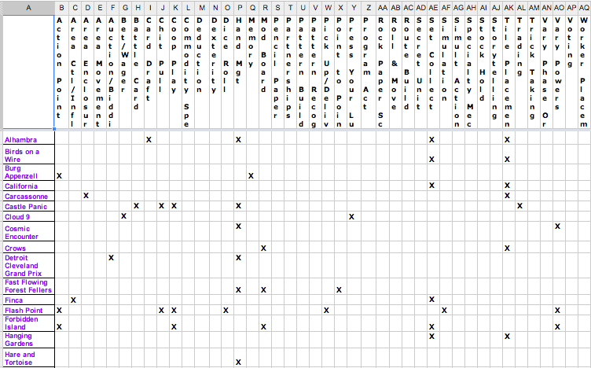

Slide 19
The Process: Playing Games
Essential to being an informed designer
Experience a variety of mechanics, themes, objectives
Students have to read rulebooks, learn the game, and teach the game to their gaming group.
Learn how to approach games from a designer’s perspective, not just a player’s.
http://www.kathleenmercury.com/establishing-a-game-design-friendly-classroom.html

Slide 20
The Process: Gaming Groups
Cohort approach—I put students in gaming groups that remain fairly constant throughout the semester
Each student designs their own game, but have partners who are cognizant of their game’s development and help shape it along the way
Tend to keep kids in groups of their friends
I mix it up during playtesting

Slide 21
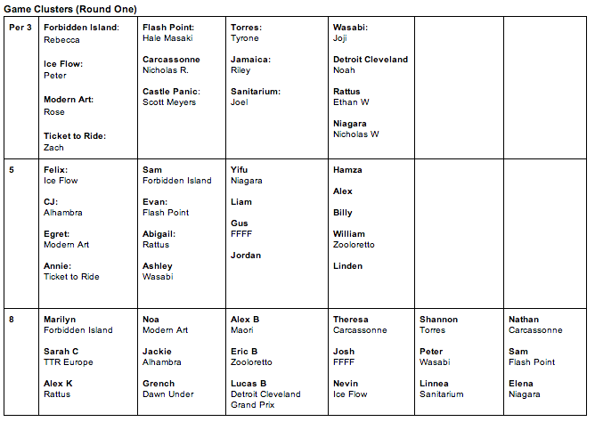

Slide 22
The Process: Modding a Game
Short activity where students take an existing game, apply new mechanics to it
Institute of Play: Rock Paper Scissors
“Luck Game Conversion”: Sorry, Candyland, Chutes and Ladders
Gentle step towards game design
http://www.instituteofplay.org/

Slide 23
The Process: Modding a Game
Student Example:
G.I.Joe. Vs. Cobra And Two Other Bad Guys
Chutes and Ladders
Converted board to terrain
Ladders became mountains, Chutes became rivers
Extra pawn base became a magic helmet: objective to capture the helmet and eliminate opposition
G.I. Joe: 7 points to take out
Cobra, Two Others: 3 points each

Slide 24
The Process: Theme & Conflict
Theme: the scenario world in which to immerse players
Must be passionate about their theme
Brainstorm, quick and dirty research
Halfway through—talk about conflict
Analyze a game’s plot structure
Choose theme on basis of content and conflict

Slide 25
The Process: Theme & Conflict
Student examples:
Partying Pacifist (Somali) Pirates to build the best disco
Dungeon crawling against monsters
Computer hacking to impress an online girlfriend
Bank robbing
Cows in space, jumping over moons to settle them
Guiding narwhals to breeding areas
Bees fetching honey to make the queen bee happy

Slide 26
The Process: Revisiting Mechanics
Run theme through a mechanics filter
What mechanics seem like they might be a good fit?

Slide 27
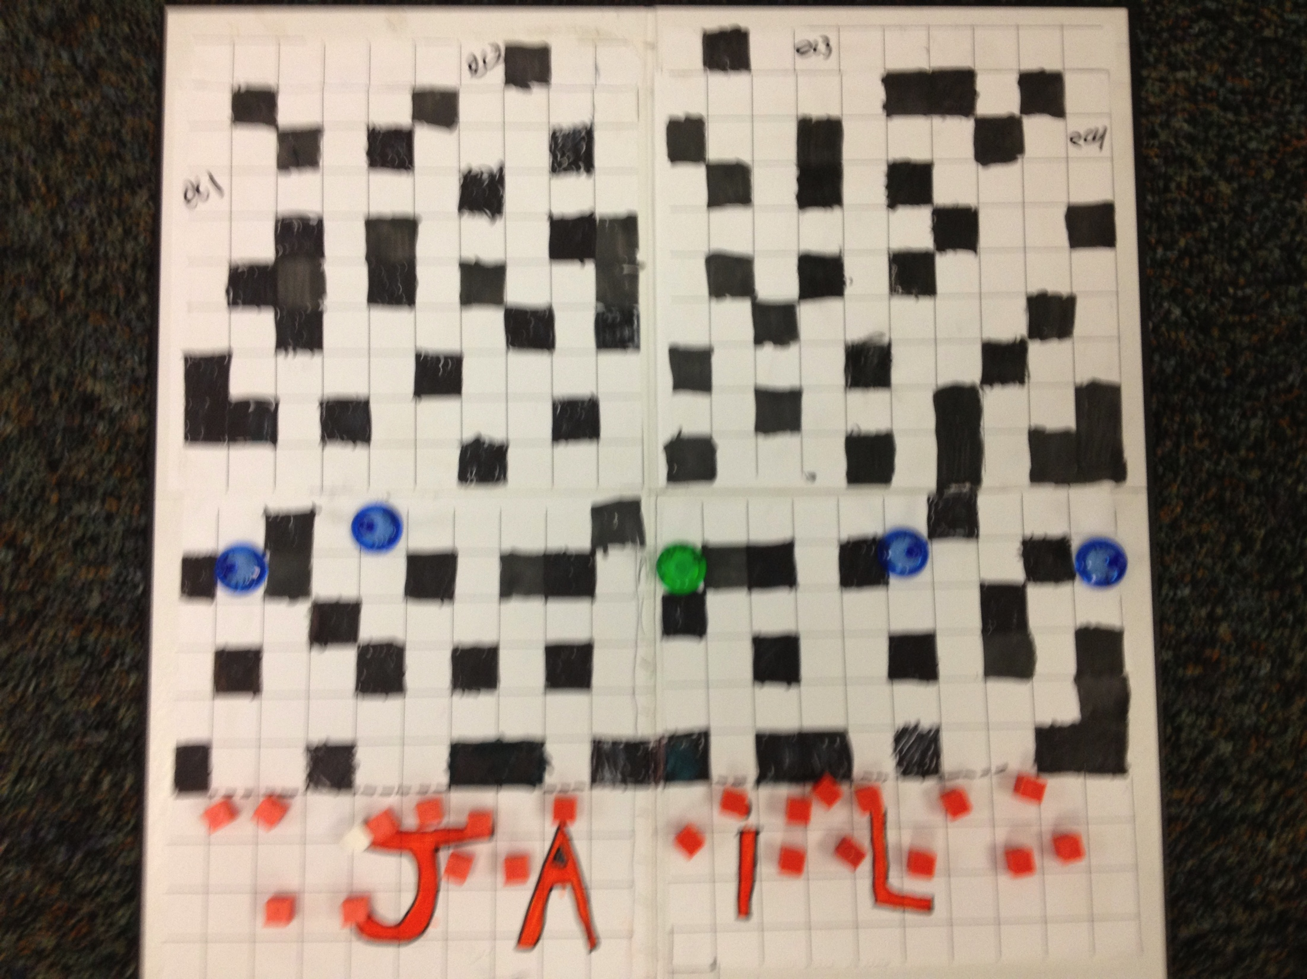
The Process: Prototype Development
Each student starts the class with blank, square, and hex paper they are encourage to experiment with
Actual prototype—FAST & CHEAP

Slide 28
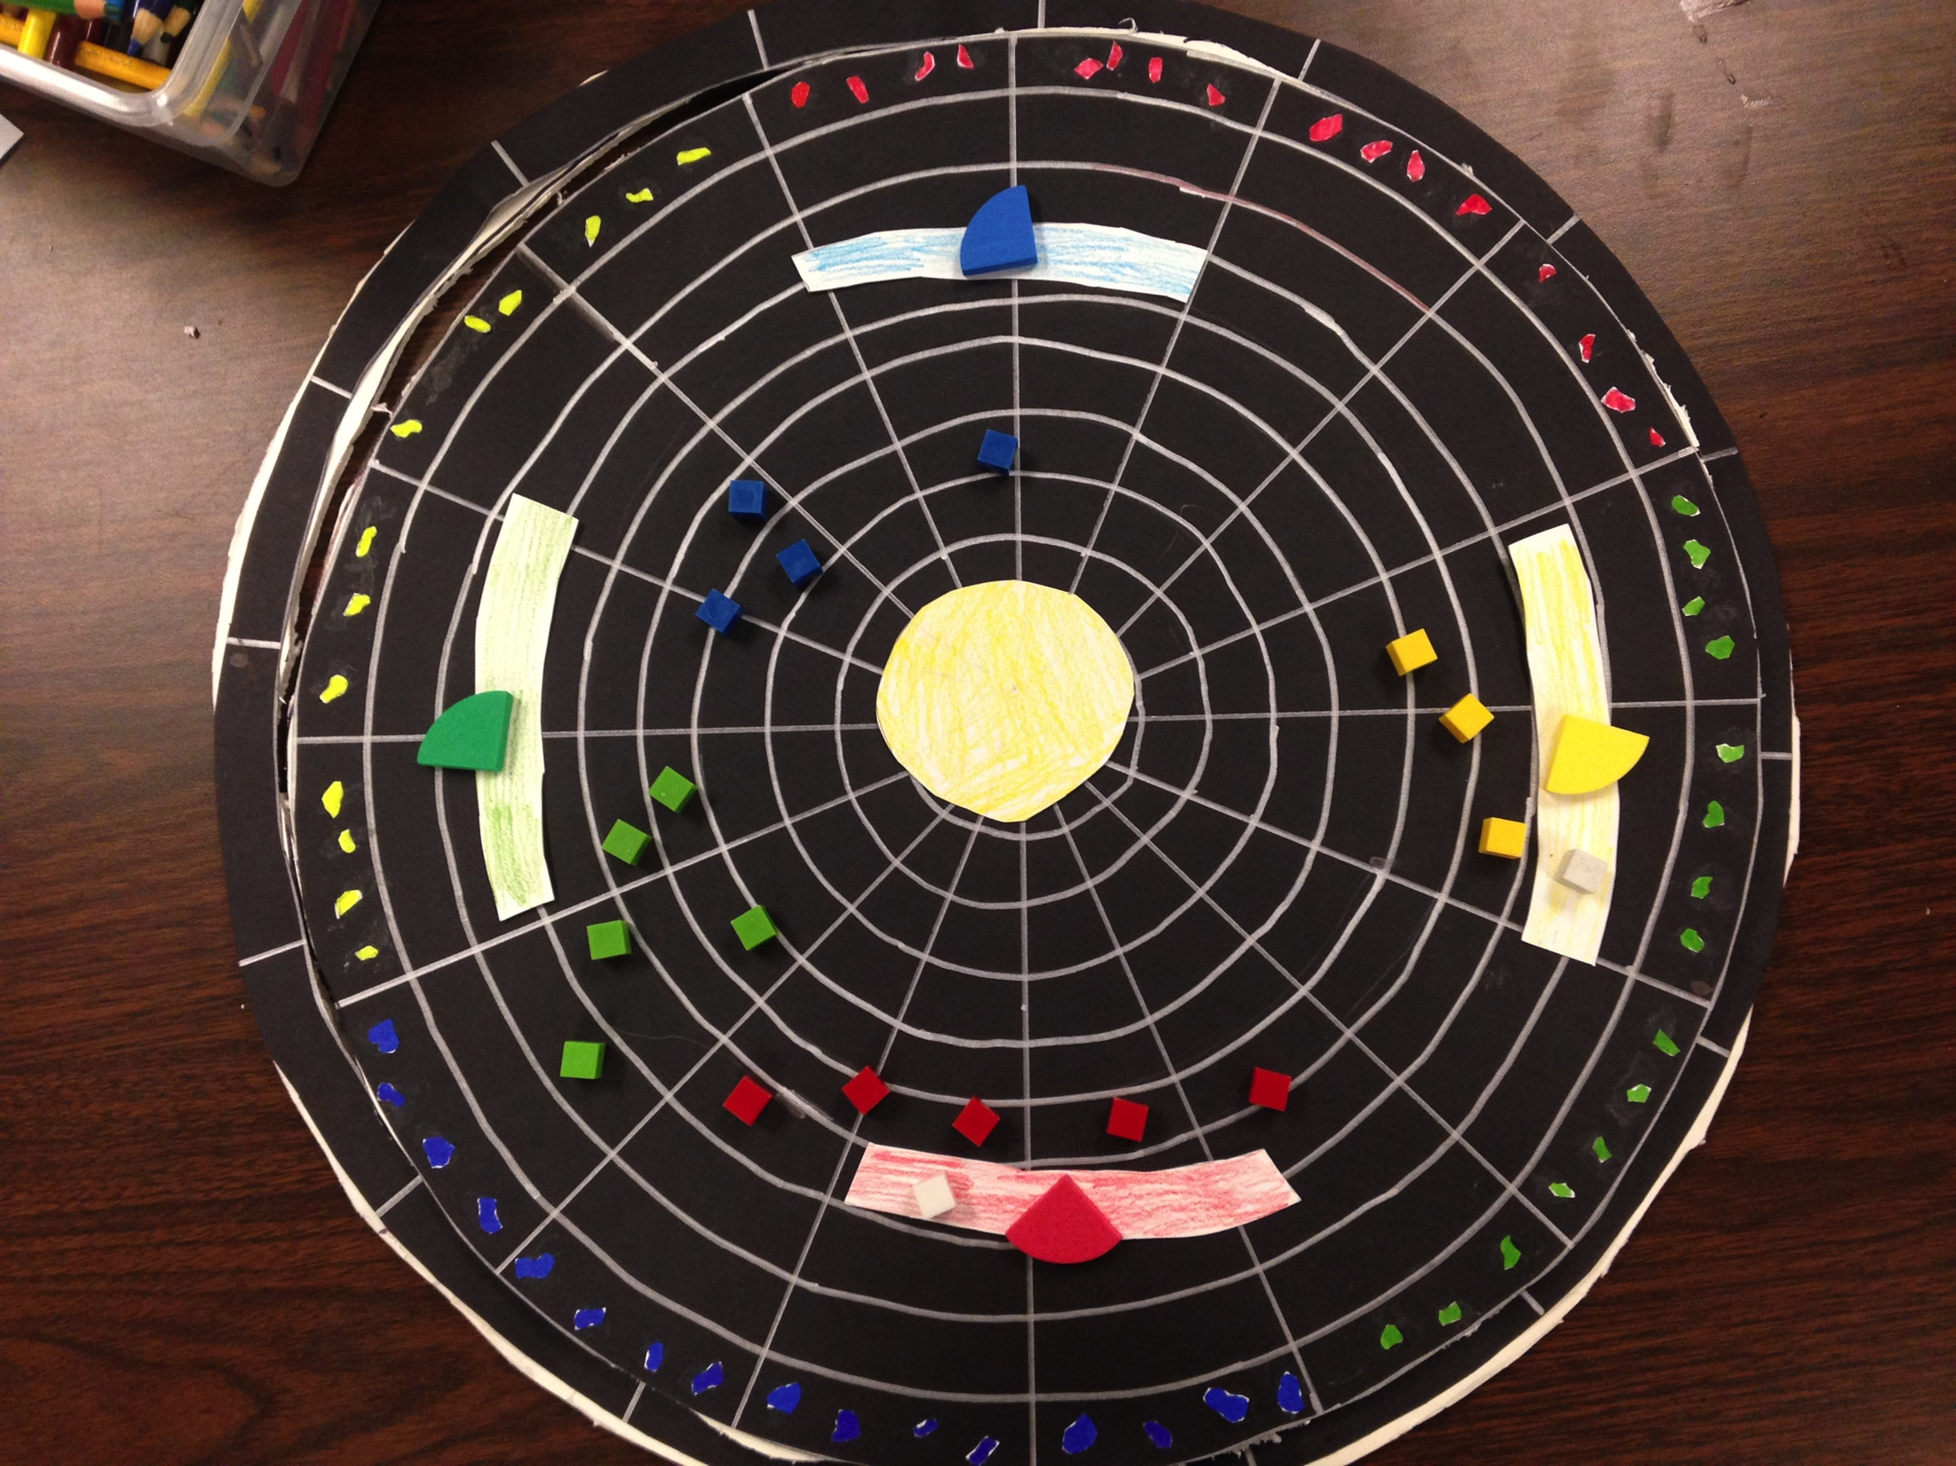
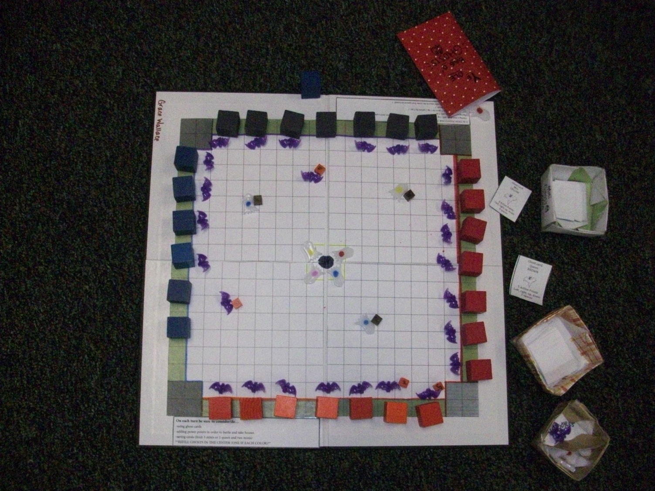
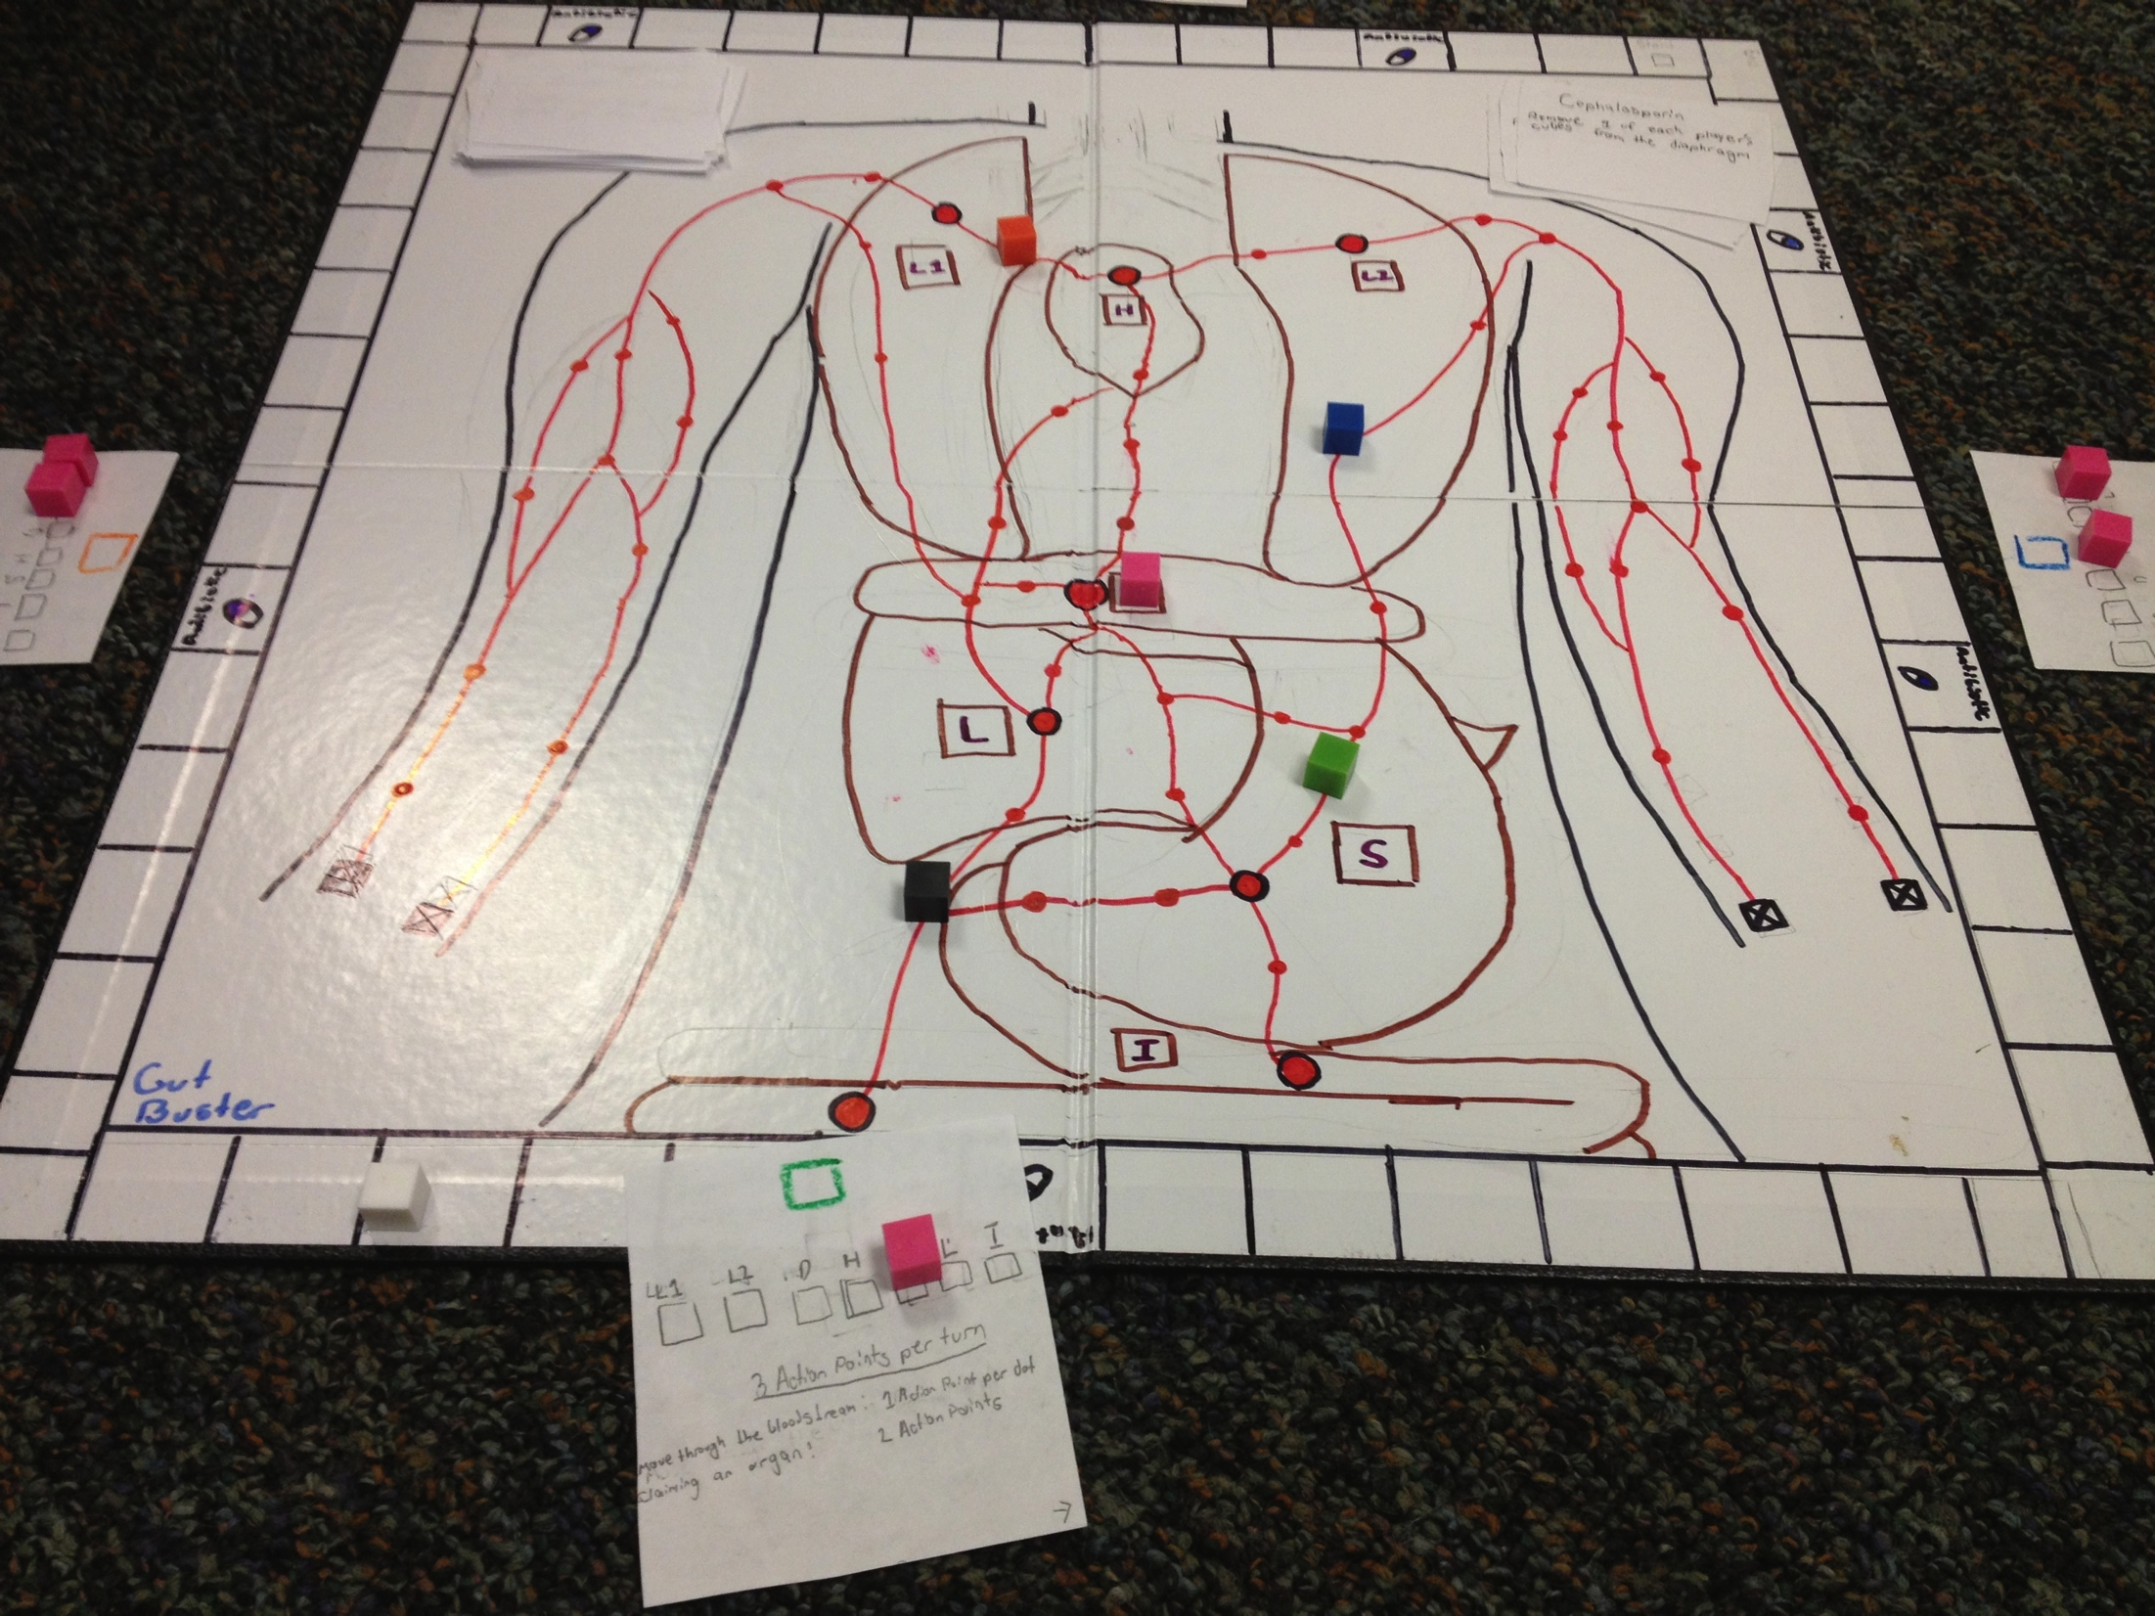

Slide 29
The Process: Prototype Development
Using 17x11 paper (blank, square, or hex grids) and recycled game bits, students create their prototypes.
Target $.97 bins = <3
Templates and other resources

Slide 30
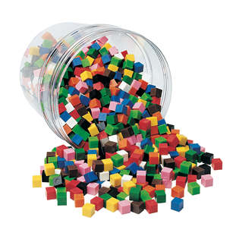
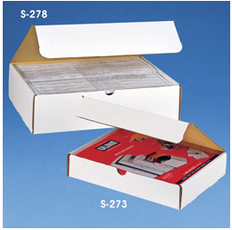
The Process: Prototype Development
Sources
Learning Resources centimeter cubes
Garage Sales, Thrift Stores, other gamers
Uline Literature mailer boxes

Slide 31
The Process: Victory Conditions
I wait to talk about victory conditions (objective and end game conditions) until they have playtested different mechanics and their theme
Victory conditions tend to evolve naturally, but I give them more information when they are ready for different options.

Slide 32
The Process: Playtesting
Gaming groups for playtesting are made of their cohorts AND mixed to get different perspectives
WINQ
What Works?
What Needs Improvement?
New Ideas?
Questions for the Designer?
Designers get the feedback sheets, write a reflection.

Slide 33
The Process: Rules
Online Google Doc Rules Template
Required categories
Title, Story
Objective
Components, Setup
Gameplay
Game End
Victory Conditions
*Challenge Rules or Strategy Hints
*Player Aid (separate document)

Slide 34
The Process: Finalizing the Prototype
The Final Prototype & Assessment
Game Title, Company Logo
Thematic images, shapes, symbols, and/or colors
Pictures or drawings as needed
Layout of game (paths, maps, images)
High quality pieces, bits, and/or cards that reflect the theme of the game
Separate Player Aid that looks like the main game and summarizes the rules
Typed Ruleset that includes diagrams or pictures of the game board.
Optional: stiff game board (optional, provided).

Slide 35
The Process: Selling Your Game
I create a Geeklist on BGG, enter their games as “unpublished prototype” then in the description upload a picture and their answers to the following prompts:
Short description of theme and objectives
Short description of gameplay
Why they chose the theme
Mechanics used
How players win and how the game ends
Why their game is awesome and amazing

Slide 36
The Process: Selling Your Game

Slide 37
Miscellaneous: Suggestions
This is hard. There are no right answers. Know your students and help them set reasonable goals and expectations for themselves and their games.
Know when to listen, when to ask questions, when to make specific suggestions to get them out of a rut.
Afterschool game clubs promote gaming, provide playtesting opportunities and help develop your game designers
Storage of in-progress games is boring but necessary. Have a plan.
Much of students’ success is due to time management.
Goal-setting and clear deadlines (with support)

Slide 38
Miscellaneous: Suggestions
Decide on your schedule, student, and school-friendly limitations
Mine:
No sports or war themes
No roll and move
No event decks
No “killing”
No player elimination
Use and teach common sense in online interactions
I deduct points for messing with other students’ work on shared documents or on BGG.

Slide 39
Miscellaneous: Suggestions
Some semesters I give students all the materials ahead of time as a big game packet (helps to them to self-pace themselves), othertimes in small chunks
If students can’t come up with a theme, have them pick an animal they like. Animals’ lives are all conflict. They can go from there.
Good ideas are never finished.

Slide 40
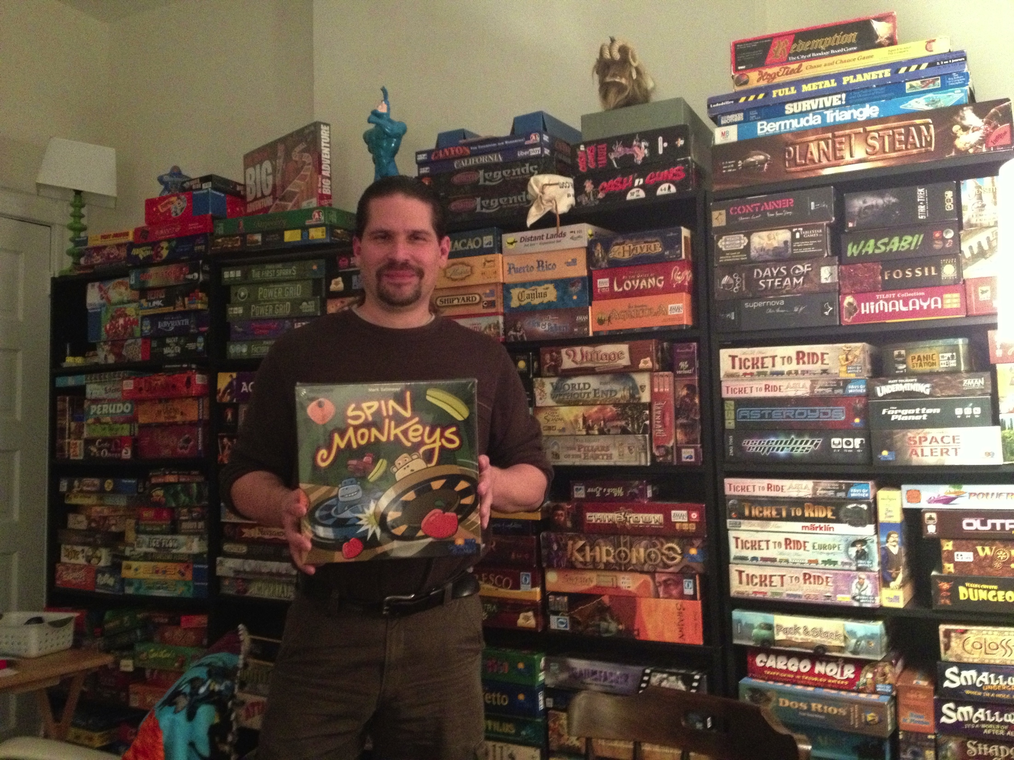
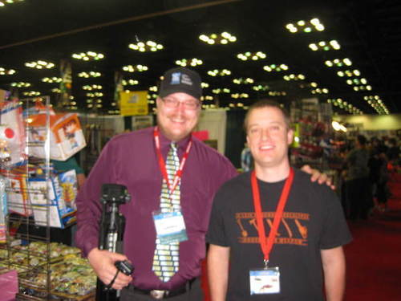
Miscellaneous: Game Designer Visits

Slide 41
Miscellaneous: Do This Better Than Me
Teach CAD or graphic design to generate game boards, cards, and other resources
Upload to Game Crafter, sell
3-D printer to create custom bits
Select one game and self-publish it using crowdfunding websites (kickstarter, indiegogo)
Create games as print and play, post on BGG

Slide 42
Questions?

